Slide 1
Penetration Testing Project
Sabih Qureshi – 221531
Mehreen Umer – 221541
Saif Ur Rehman – 221547
Amna Naeem - 221573
Password Cracking and Cracking Algorithms

Slide 2
Introduction
What is Password Cracking?
Evaluating password strength in penetration testing.
Identifying vulnerabilities in password-protected systems.
Password cracking is a critical aspect of penetration testing.
Importance:
Highlighting weak passwords.
Strengthening security policies.

Slide 3
Project Outline
Demonstrate practical password-cracking techniques.
Evaluate the strength of hashed passwords.
Identify weaknesses in common authentication mechanisms.
Provide actionable recommendations for improved password security.
Hydra
Medusa
Hashcat
John The Ripper
WpScan
Metasploit

Slide 4

John the Ripper
John the Ripper is a versatile open-source password-cracking tool.
It supports various file formats and employs brute-force and dictionary based attacks.
Key Features:
Supports cracking PDF, ZIP, and DOCX files.
Utilizes brute-force and dictionary attacks.
Widely used in penetration testing and security audits.

Slide 5

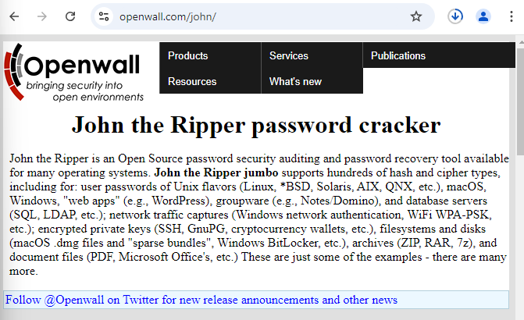
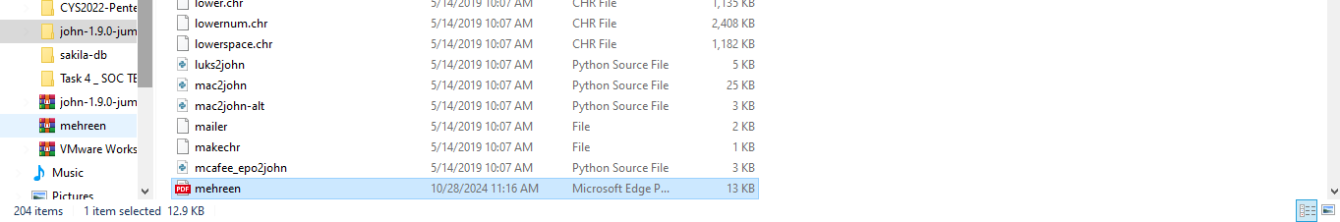
Installation And Configuration
Install John the Ripper for windows from OpenWall.
Determine the wordlist
"john --wordlist=rockyou.txt file.hash“
Place the password-protected PDF in the run folder.

Slide 6
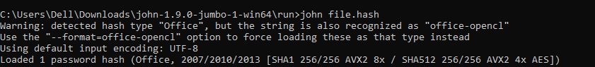
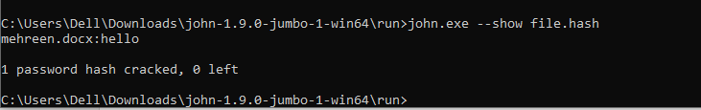
Cracking the Password of Pdf Files
Create a hash of the protected PDF:
python pdf2john.py filename.pdf > 1file.hash
Crack the password using brute-force:
john file.hash
To display the cracked password:
john.exe --show file.hash

Slide 7

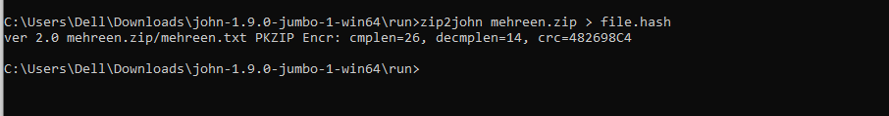
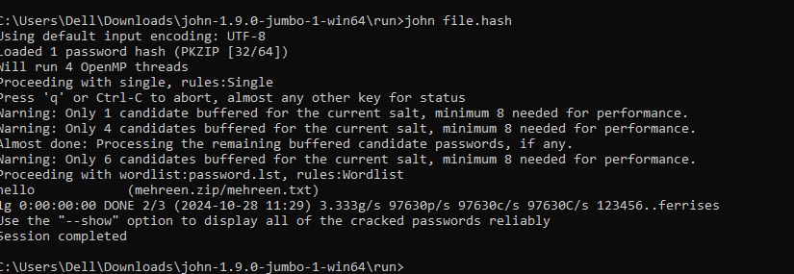
Testing of Protected Zip Documents

Slide 8
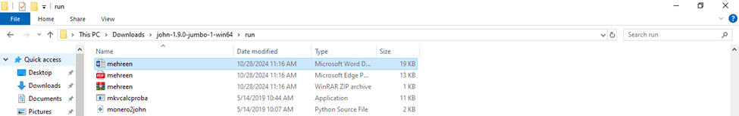
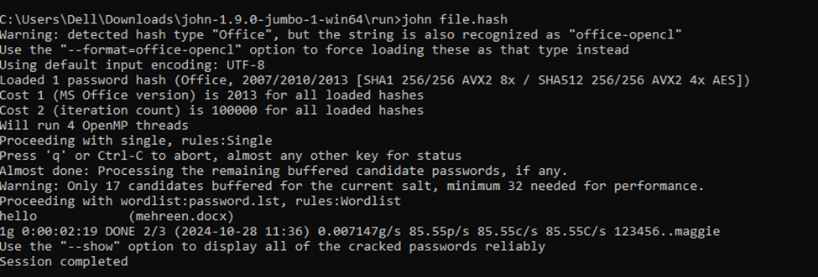
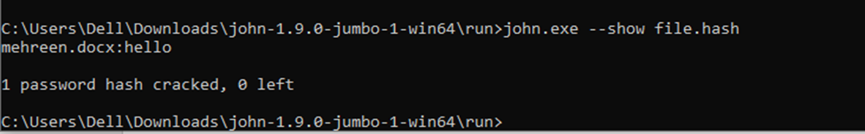
Testing of Protected DOCX

Slide 9
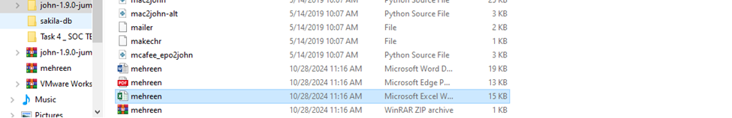
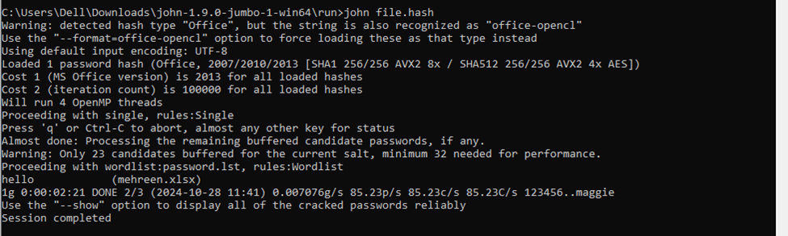
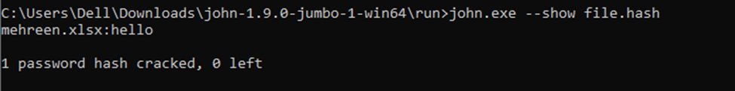
Testing of Protected Excel

Slide 10

Hydra - Overview
Hydra is a fast and flexible network login cracker.
It supports multiple protocols, including FTP, SSH, and HTTP.
Key Features:
Performs brute-force attacks on network services.
Supports custom password lists for targeted attacks.
Highly effective for testing authentication mechanisms.

Slide 11
Hydra - How to Use
Install Hydra on your testing environment.
Prepare a password list (e.g., rockyou.txt).
Run the command:
"hydra -l user -P passlist.txt ssh://192.168.1.1"

Slide 12
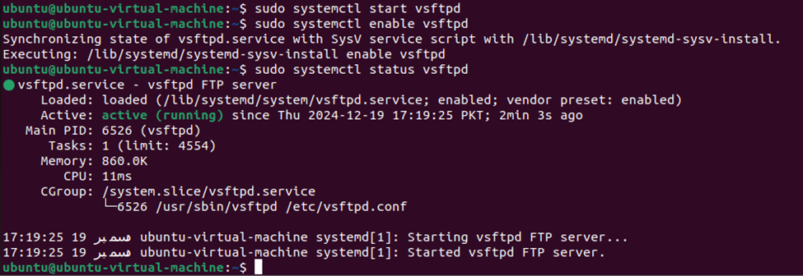
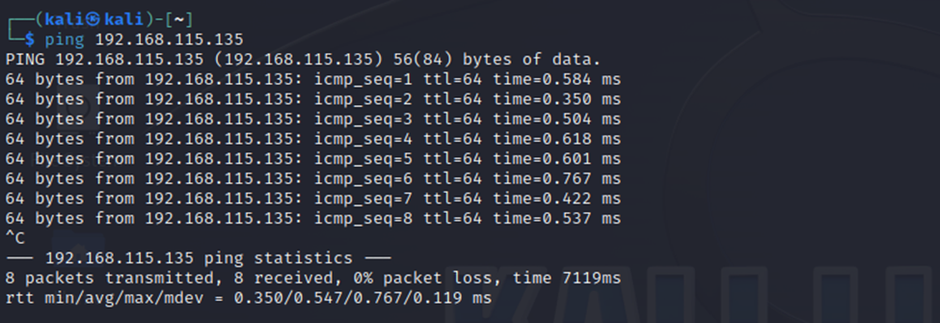
Cracking the FTP login password using Hydra
Install Hydra on your testing environment.
sudo apt install hydra -y
Setting The Ubuntu Machine as FTP server:
First for verification of ftp server working, try to ping the Ubuntu machine from the kali machine.

Slide 13
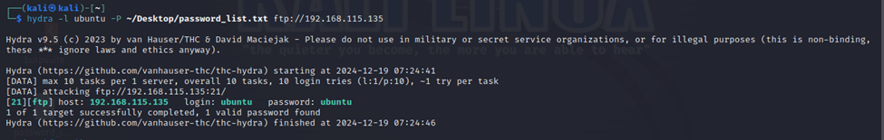
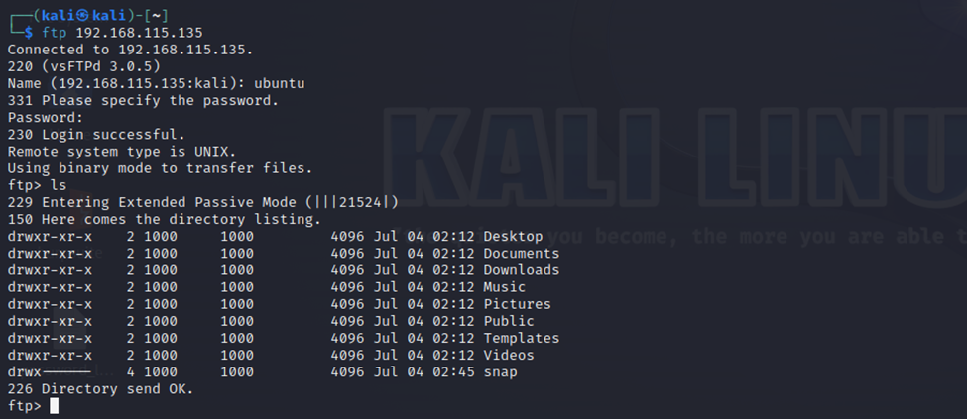
Cracking the FTP login password using Hydra
Perform the Brute Force Attack
hydra -l <username> -P <path_to_your_password_list> ftp://<Ubuntu_IP_address>
Log into the target machine from the host machine using the FTP service

Slide 14
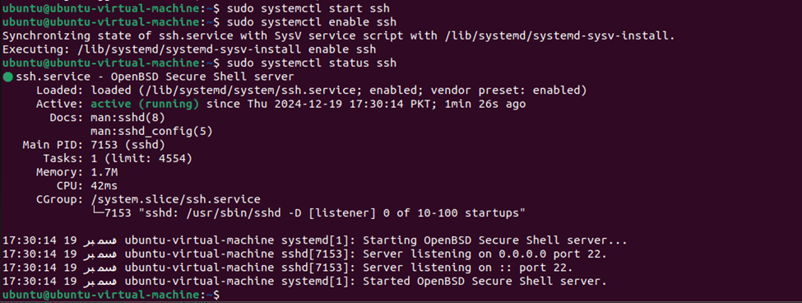
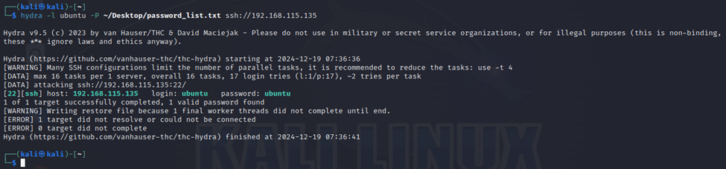
Cracking the SSH login password using Hydra
Setting up Ubuntu Machine as victim
hydra -l <username> -P ~/Desktop/password_list.txt ssh://192.168.115.135

Slide 15
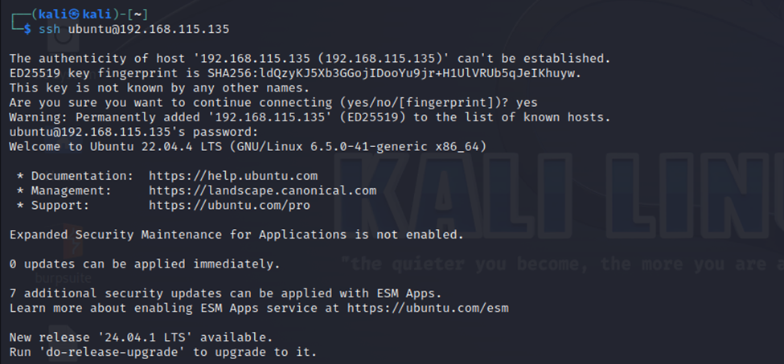
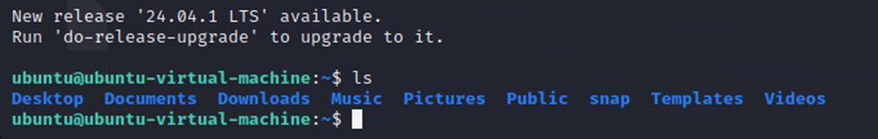
Result
[22][ssh] host: 192.168.115.135 login: ubuntu password: ubuntu
Once you have the correct password, you can SSH into your Ubuntu machine from Kali:
ssh ubuntu@192.168.115.135

Slide 16

Medusa- Overview
Medusa is a versatile and high-speed parallel password-cracking tool.It supports a wide range of network protocols, including FTP, SSH, HTTP, and Telnet.
Key Features:
Executes parallel brute-force attacks on various network services.
Supports customizable input files for usernames and passwords.
Efficiently tests large-scale authentication systems.

Slide 17
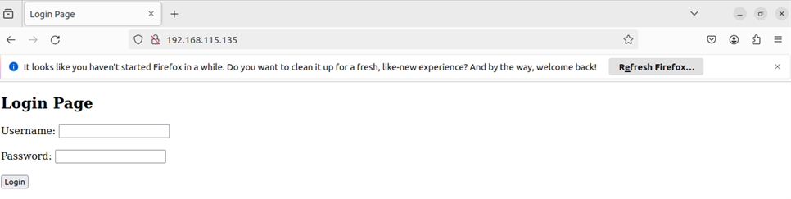
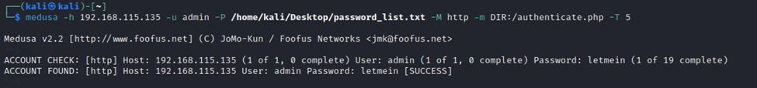
For Linux (Debian/Ubuntu), you can install it using the APT package manager, like this:
sudo apt install medusa
Created and authenticated a login page
medusa -h example.com -U usernames.txt -P passwords.txt -M http –m FORM:/login.php:username_field=password_field -t 5

Slide 18
Hashcat – Overview
A powerful tool for password recovery by cracking hash values. It supports both CPU and GPU for efficient processing.
apt install hashcat
Key Concepts:
Password Hashing: Converts plaintext passwords into fixed-length hashes using algorithms like MD5, SHA-1, and SHA-256.
Example MD5 hash for password: 5f4dcc3b5aa765d61d8327deb882cf99.
Hashcat Modes:
Dictionary Attack (-a 0): Uses a wordlist to guess passwords.
Supported Hash Modes:
MD5: -m0
SHA-1: -m 100
NTLM: -m 1000

Slide 19
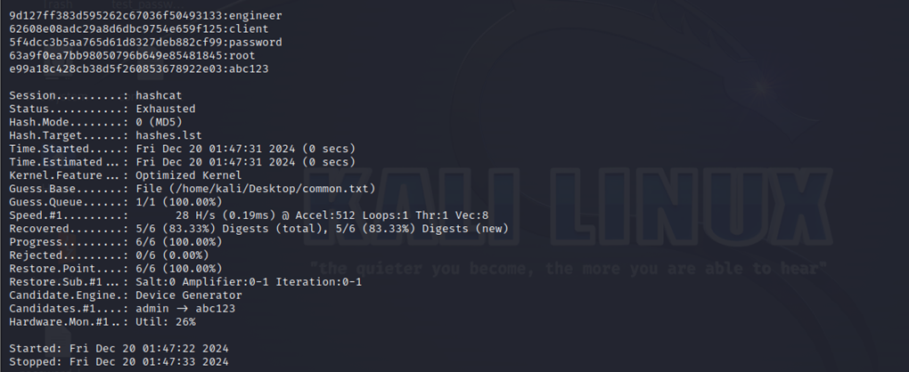
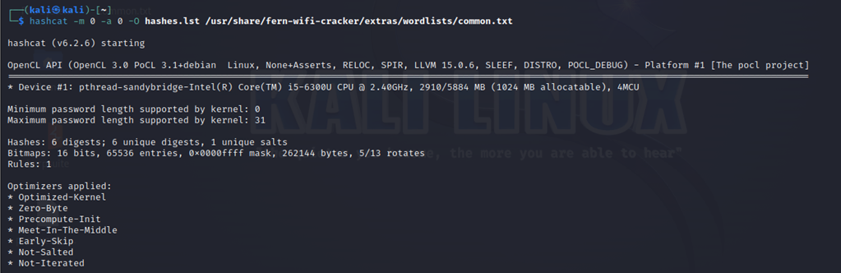
Md5 Password Recovery
hashcat -m 0 -a 0 -O hashes.lst /usr/share/fern-wifi-cracker/extras/wordlists/common.txt

Slide 20
Cewl- overveiw
Custom wordlist generator that scrapes websites for keywords, emails, and other data useful for password cracking
1.Generate Wordlist:
cewl http://example.com -w wordlist.txt
Saves the wordlist to wordlist.txt
2.Email Extraction:
cewl http://example.com -e –n
Retrieves emails from the website.
3.Set Minimum Word Length:
cewl http://example.com -m 10 -w wordlist.txt
Filters words with a minimum of 10 characters

Slide 21
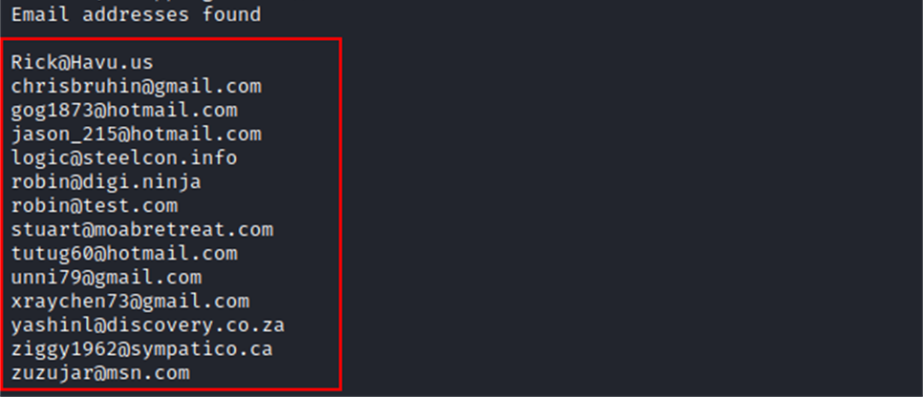
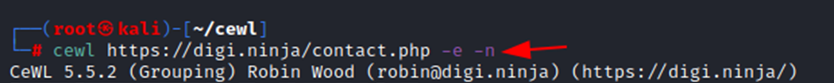
Cewl-Main Commands and Testing
1.Count Word Repetitions:
cewl http://example.com –c
2.Authentication Support:
cewl http://example.com/login.php --auth_type Digest --auth_user user --auth_pass pass –v
Bypasses login pages with provided credentials
Test-Retrieve emails from Website

Slide 22
WpScan –Overview
WPScan is a WordPress vulnerability scanner that is pre-installed in Kali.
Key Features:
Detect WordPress core vulnerabilities.
Enumerate installed plugins and themes.
Identify weak passwords via brute-force attacks.
Discover usernames and default settings.
Check for security misconfigurations.
Main Commands:
1.Scan a WordPress Website
wpscan --url http://example.com
This will perform a general scan of the WordPress site.
2.Enumerate Plugins
wpscan --url http://example.com --enumerate p
This command lists the plugins installed on the WordPress

Slide 23
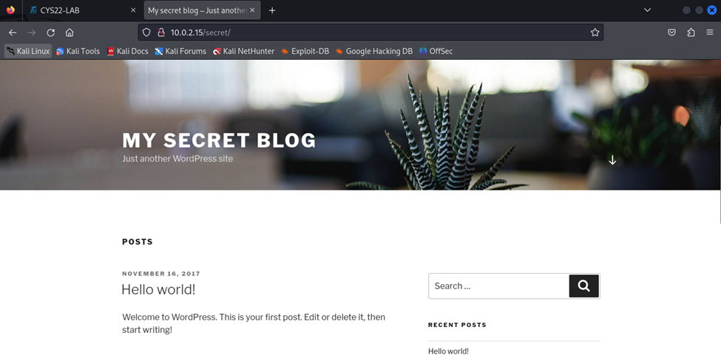
3.Enumerate Theme
wpscan --url http://example.com --enumerate t
4.Enumerate Username
wpscan --url http://example.com --enumerate u
This identifies the usernames of WordPress accounts.
5.Perform a Brute-Force Attack
Use this option to test weak passwords for WordPress accounts.
wpscan --url http://example.com -U usernames.txt

Slide 24
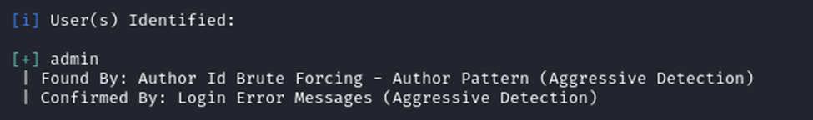
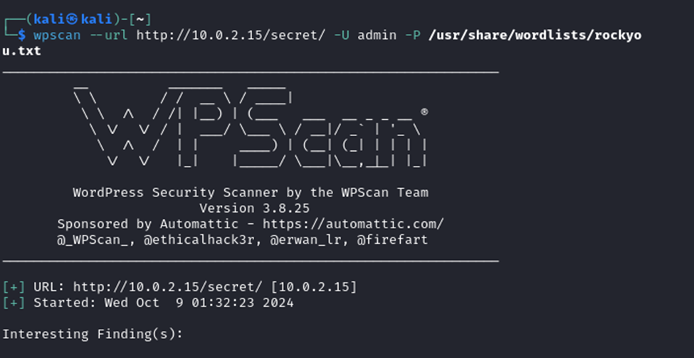
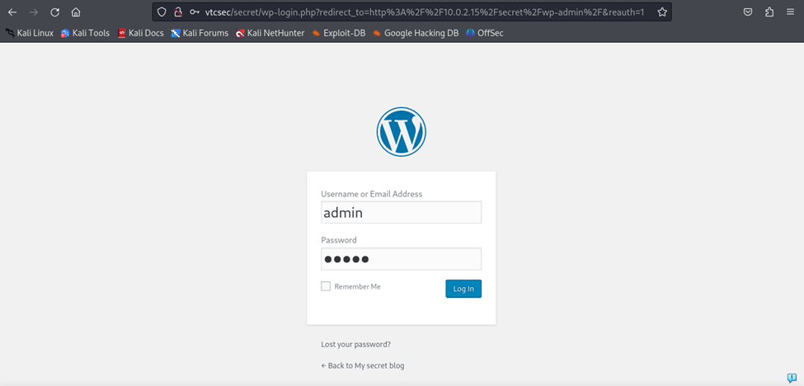
After username enumeration

Slide 25
Metasploit – Overview
Metasploit is one of the most popular penetration testing frameworks.
Features:
Exploitation of vulnerabilities.
Integration with payloads for privilege escalation.
Post-exploitation modules for data gathering.
Auxiliary tools for scanning and information gathering
we will walk through

Slide 26
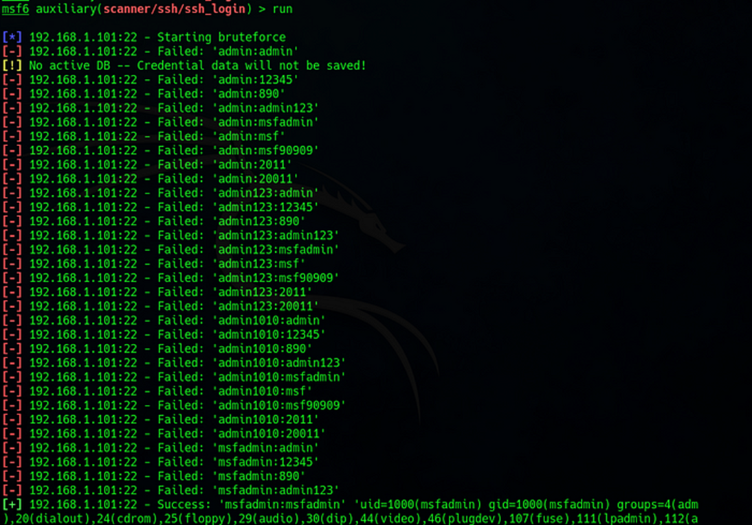
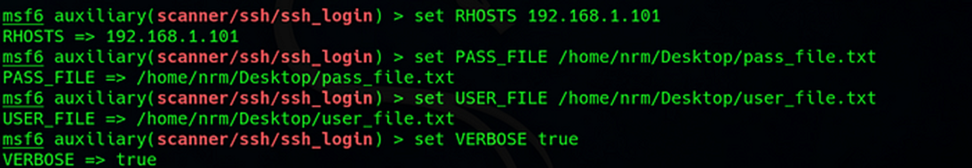
Brute-forcing SSH on a Metasploitable 2 VM using Metasploit
Found the IP of machine via nmap scan
nmap -sn 192.168.0.0/24

Slide 27
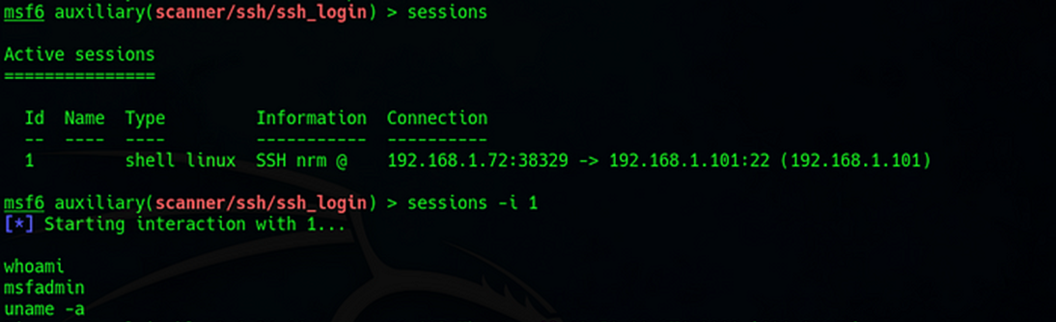
Brute-forcing SSH on a Metasploitable 2 VM using Metasploit
Metasploit will now attempt to log in to the target SSH server using the provided username and password lists. This process may take some time depending on the size of your lists and the network speed.
ssh username@target_ipaddress

Slide 28
THANKYOU!

